Slide 1
Cost Estimator Project
Teams- Express & Adonis

Slide 2
Our Client
Instructors
Curt Carpenter
C&G Coatings
Dr. Ajay Bandi
Dr. Denise Case

Slide 3
Introduction
A cost estimating app to quickly estimate and quote job costs.
This application has only one user i.e, Curt.
What is an estimate ?
A cost estimate is the approximation of the cost of a program, project, or operation. The cost estimate is the product of the cost estimating process. The cost estimate has a single total value and it comprises various components.
Notes:
Source: https://en.wikipedia.org/wiki/Cost_estimate

Slide 4
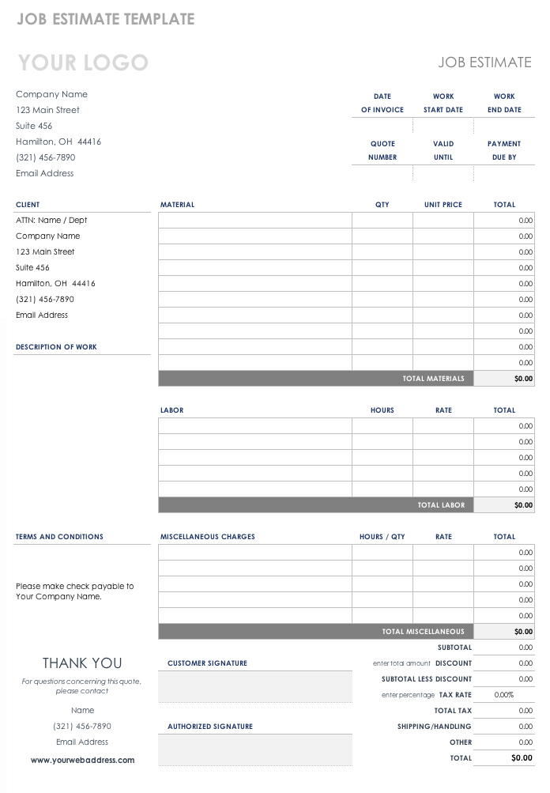
Introduction(Contd..)
A sample of manual estimate sheet
Notes:
Source: https://www.smartsheet.com/job-work-estimate-templates

Slide 5
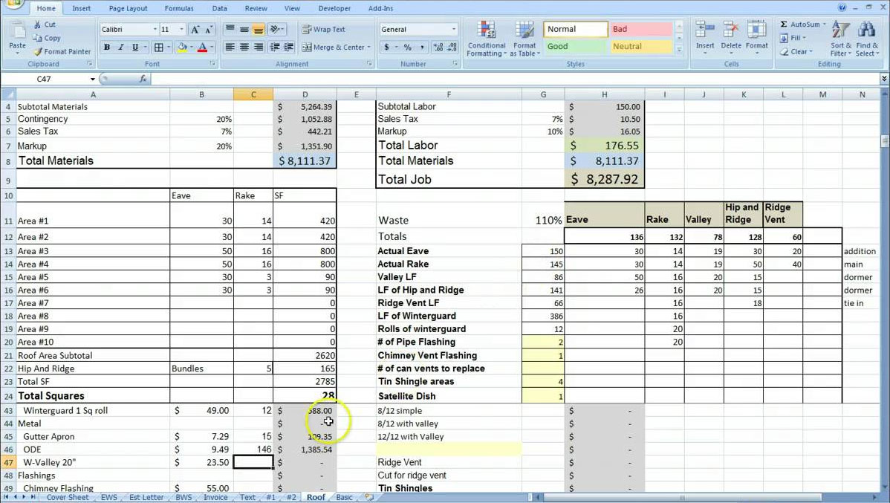
Introduction(Contd..)
Excel sheet estimate sheet
Notes:
Source:https://golagoon.com/estimating-spreadsheet-template/excel-spreadsheets-help-trip-cost-estimator-spreadsheet-template-project-estimate/

Slide 6
Introduction(Contd..)
An estimate is calculated by summing up the various components.
Labor cost
Hotel cost
Vehicle cost
Food cost
Material cost
Miscellaneous costs
Notes:
Source: https://www.smartsheet.com/job-work-estimate-templates

Slide 7
Introduction(Contd..)
A cost estimating app to quickly estimate and quote job costs.
It is a progressive web application in which a user can login and can perform CRUD(create, view, update and delete) operations on the estimates.
It is developed on the requirements given by the curt carpenter.

Slide 8

Problem Statement
Creating and storing estimates manually is a tedious task.
Excel sheet estimates
Manual entry of each attribute in an estimate is difficult.
A user need to write a new and complete estimate every time even if there is a similar estimate completed previously.

Slide 9


Proposed Solution
We have decided to help our client get rid off the problems seen previously by providing him a web application.
This helps to create fast estimates and is easy for a non-technical client.
Copy any previous similar estimate if required.
Simple way to edit an estimate.
Feature to filter any unwanted or non-legitimate estimates.

Slide 10

Requirements
A public page with contact information for the company and link to their Facebook page and/or website.
An opening page to show recent recorded estimates after logging in.
Administrator log in (so only authorized users can create estimates) or authorized estimates can be created.
Read all the requirements through text entry boxes and use of drop downs where required.

Slide 11
Requirements
An easy way to create a new estimate, either by starting with the default values or by copying from an existing estimate.
While creating a new estimate, show the job cost in dollars and $/sqft.
Use of symbols like ‘+’, copy estimate, 🗑️, ✎ .
Work saved after every modification, no need to worry about clicking save after every entry.

Slide 12













Tools and Technologies
Front-End | EJS, Bootstrap 4, CSS 3
Back-End | Node JS
DataBase Technologies | Mongodb, MySQL
File Management (Cloud Repo) | Git Version Control System
IDE for development | Visual Studio Code
Testing Tool | Selenium
Mail service for App | Mailgun
Integration Tool | Heroku Auto Deployment
Temporary App development | Local Host
Communication (Internal & External) | Email, Slack, Facebook, Google Docs
Notes:
SELENIUM :
JAVASCRIPT based is an open source web testing tool
MAILGUN

Slide 13
Deployed Link
https://curtestimator.herokuapp.com

Slide 14
Thank you

